Slide 1
BIOINFORMATICS
presentation by
Zubareva Natalia
BSE 195

Slide 2
What is it
an interdisciplinary field
aims
biology
biochemistry
molecular life
tools
nanoengineering
computer science
mathematics
Search
Integrate
Model
Compare
Notes:
a very interdisciplinary science that unites a range of more traditional fields of studies with the aim of getting a better understanding of natural processes
it lies in the area of biology and focuses on the life on micro and nano level, and its objects and their interactions - for example organic molecules, clusters of them, their structural parts,
to do that, information is collected, compared, visualized and shared with the use of modern tools like statistics, mathematics, computer science with its capacity for data storage and analysis, nanoengineering as means of physical observations

Slide 3
History
1902
1950
1968
1970
protein sequences
the term bioinformatics
proposition of proteins’ structure
Atlas of Protein Sequence and Structure
Franz Hofmeister and Emil Fischer
Frederick Sanger
Margaret Dayhoff
Paulien Hogeweg and Ben Hesper
Notes:
The science naturally evolved from biochemistry
the information in biology is dna and proteins - aminoacids
we can choose as the first point the proposal that proteins were linear chains of α-aminoacids made by two scientists, Franz Hofmeister and Emil Fischer, in 1902,
it was proved in the early 1950s. when protein sequences became available after Frederick Sanger determined the sequence of insulin
scientists begun to compare sequences, which was complicated to do manually
Margaret Dayhoff in 1968 and her collection of protein sequences known as the Atlas of Protein Sequence and Structure. after that Computers clearly became essential in molecular biology
Historically, the term bioinformatics did not mean what it means today. Paulien Hogeweg and Ben Hesper coined it in 1970 to refer to the study of information processes in biotic systems
later it became what we know it as today, the application of computer tech to process immense amounts of biological information

Slide 4
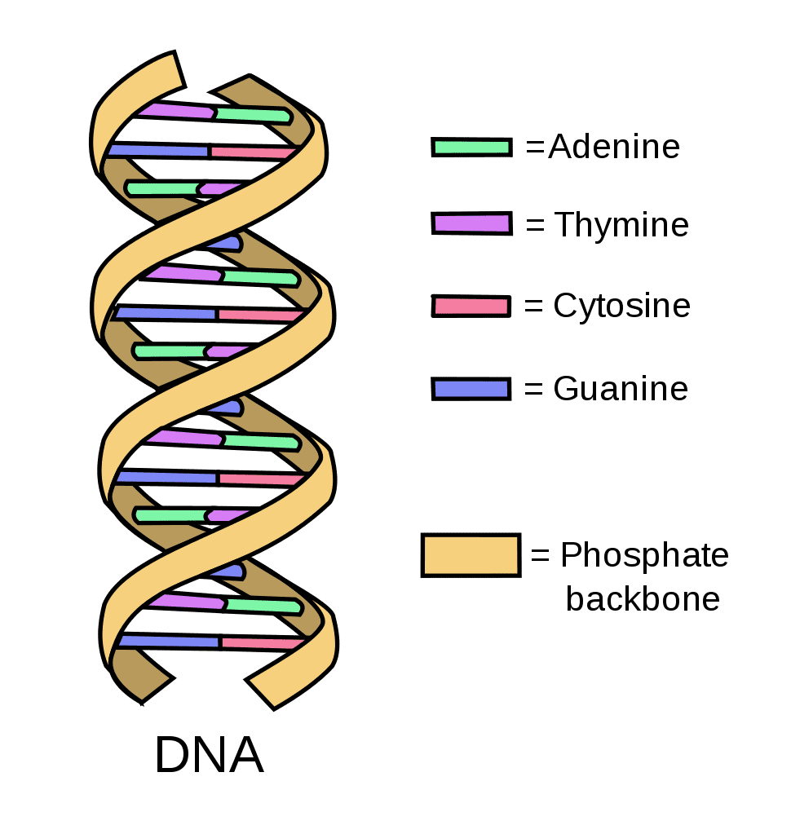
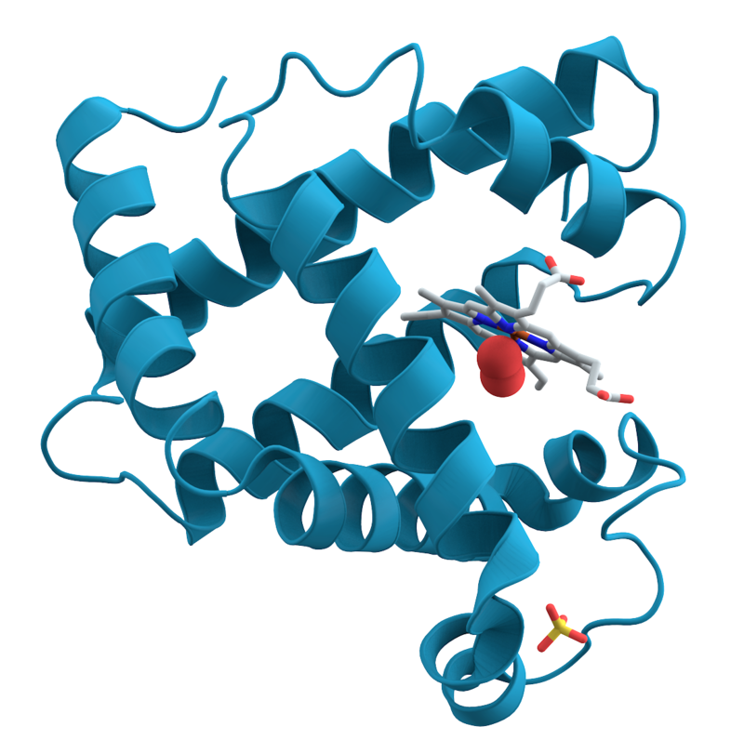
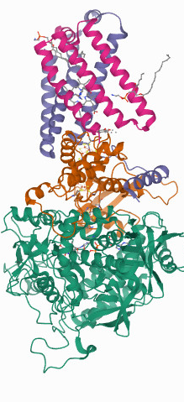
Data
nucleotide sequence
protein sequence
macromolecular structure
stored
retrieved
analyzed
Notes:
the science deals with dna, which consists of aminoacids, proteins, that do as well, macromolecular complexes that consist of mane proteins
they come in different forms that share the definition of big data - the genome, the protein sequence are large arrays of aminoacids and other structural units
this data needs to be acquired, stored, and analyzed

Slide 5
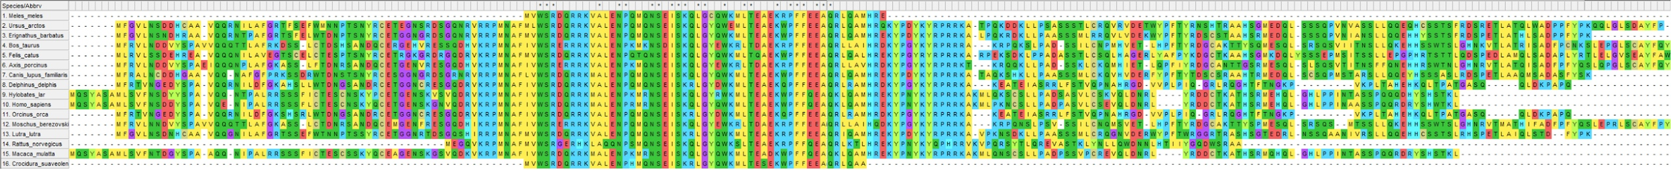
Computer science
database technology
data analysis
machine learning algorithms
mapping and matching information
modelling
Notes:
all the stages of bioinformatics are a fruitful workground for programmers, as it begins with data storage in databases
Primary databases are populated with experimentally derived data such as nucleotide sequence, protein sequence or macromolecular structure.
secondary databases comprise data derived from the results of analysing primary data. - help share the research in the community
pattern recognition, data mining, machine learning algorithms, and visualization. - all used to make sense of the information collected, draw connections and analyze

Slide 6
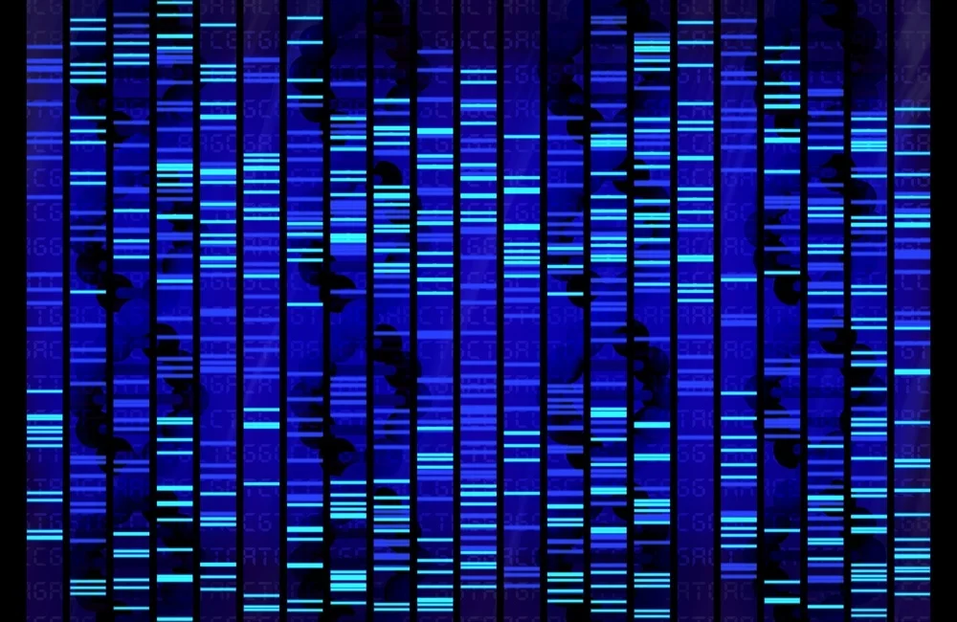
Areas of application
healthcare
pharmacology
agriculture
classical biology
evolution
sequence alignment
gene finding
drug design
genome decoding
protein structure alignment
protein structure prediction
prediction of gene expression
genome-wide association studies
modeling of evolution
cell division
Notes:
Major research efforts in the field include sequence alignment, gene finding, genome assembly, drug design, drug discovery, protein structure alignment, protein structure prediction, prediction of gene expression and protein–protein interactions, genome-wide association studies, the modeling of evolution and cell division/mitosis.
bioinformatics deal with sequence alignment, genome decoding, modelling proteins, their structural features and properties
in actual medical studies of humans and animals with understanding of causes and symptoms of various diseases, for example cancer being caused by certain viruses
it helps in pharmacy in development of new medicine, giving drug designers ways to predict the behaviour of a certain molecule
agriculture is enabled with gene engineering possibilities and technologies which help breeding and selectioning
in classical biology - insight into organic chemistry and also some benefits to the understanding on bigger systeatic levels - for example taxonomy

Slide 7
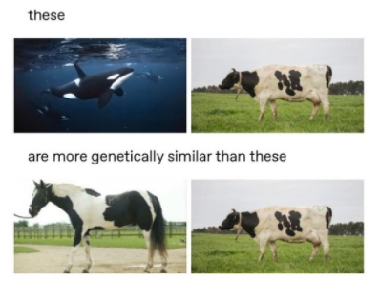
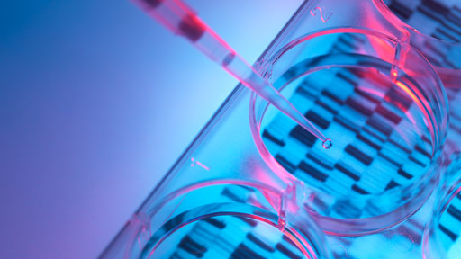
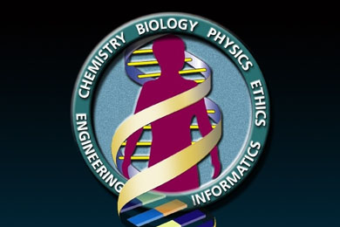
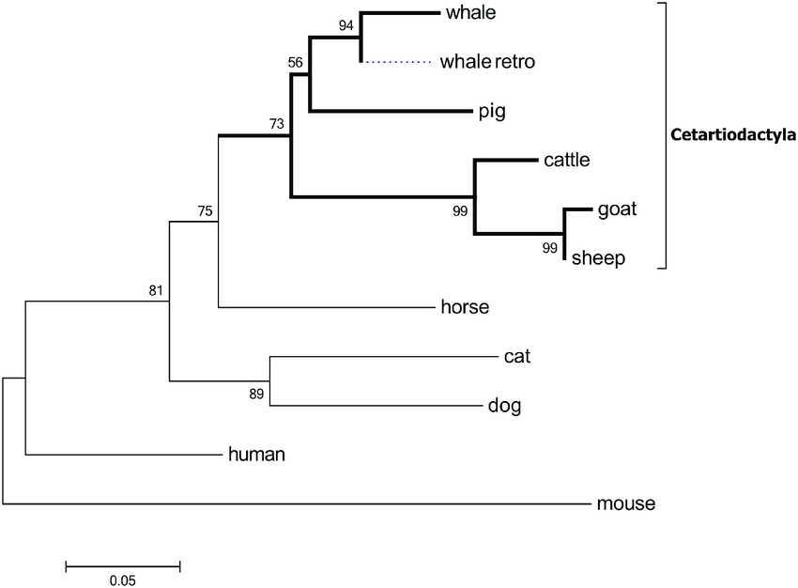
Notes:
Classical taxonomy, based on external features, on anatomy and physiology, in many cases simply did not work
In 2002, the decoding of the human genome was completed - the human genome project

